Slide 1
Four Technologies You Will Need in the Future
Donna Westmoreland
Scott Klement

Slide 2
Today’s Speakers
Donna Westmoreland, CTO,
Midrange Dynamics North America
Scott Klement, Development
and Solutions Architect,
Midrange Dynamics

Slide 3
Modern IDEs

Slide 4
Common Arguments Against a New IDE
Nobody else here uses it.
The boss won't pay for RDi
RDi is too slow, too clumsy, too buggy.
I'm very used to SEU, I can get things done faster.
I get it! I've been using it for more than 30 years myself – I'm used to them just like you are, they are easy for me!
They aren't possible for the future, though.

Slide 5
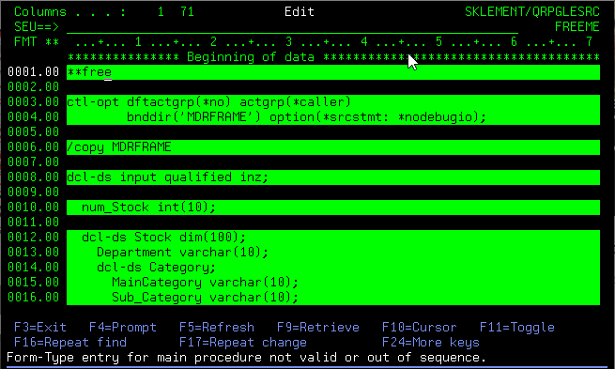
Remember This: SEU/PDM is Not an Option!
No new RPG features have been added to SEU since March 2008
That's 15 years!
Hiring/training new developers with green-screen tools is a no-go.
Are you really doing your company a favor by throwing away all new value added to the environment over the past 15 years?!?!

Slide 6
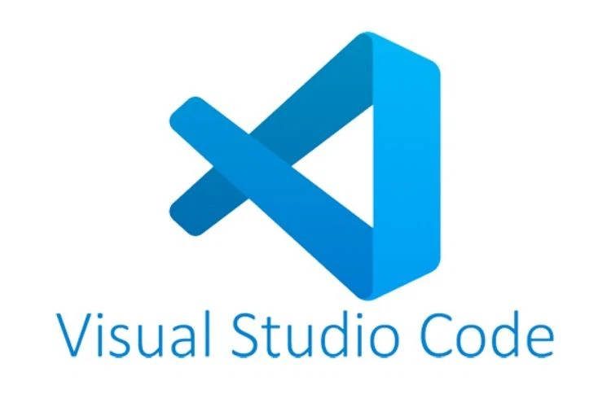
The Greatness Of New IDEs
Support for new features (as discussed)
Color themes (Dark, Light, etc.)
Colorized Code – easier to read/understand
More space on screen
Ability to view multiple members in tabs or side-by-side
Outline view – easier to understand code
Support for multiple programming languages
All systems in the same place
Offline editing
Much more friendly to new developers

Slide 7
Rational Developer for i (RDi)
Pros
Based on Eclipse
Currently the most widely used (modern) IDE
Integration with all modern change management software
Edits source for most common languages
Supports both source files and IFS
An IBM product
IBM boasts studies showing a 20% productivity improvement
Cons
Licensing can be a headache
Comparatively expensive
Many people find it slow, clumsy and confusing.
Bosses often refuse to pay for it (though, I feel that they are being silly.)
Not what all younger people expect to use?

Slide 8
Visual Studio Code (VS Code, Code for i)
Pros
100% free, open source
Cross-platform, works on Mac, Linux, Windows, etc.
The go-to IDE for most environments today (Java, Node.js/JavaScript, Python, and mode)
Rich library of plugins that all work together.
Code for i plugins from Halcyon for IBM i native code.
Tends to run faster, feel more solid than RDi
Cons
Outline view isn't quite as powerful as RDi
Debugging support is new, and has only basic features – will improve with time.
Commercial change management software isn't all available yet, but more is being added every day.
But.... Midrange Dynamics is fully committed to providing MDOpen on VS Code. I can show you what we're developing!

Slide 9
IDE Demo and MDOpen for VS Code Sneak Peek

Slide 10
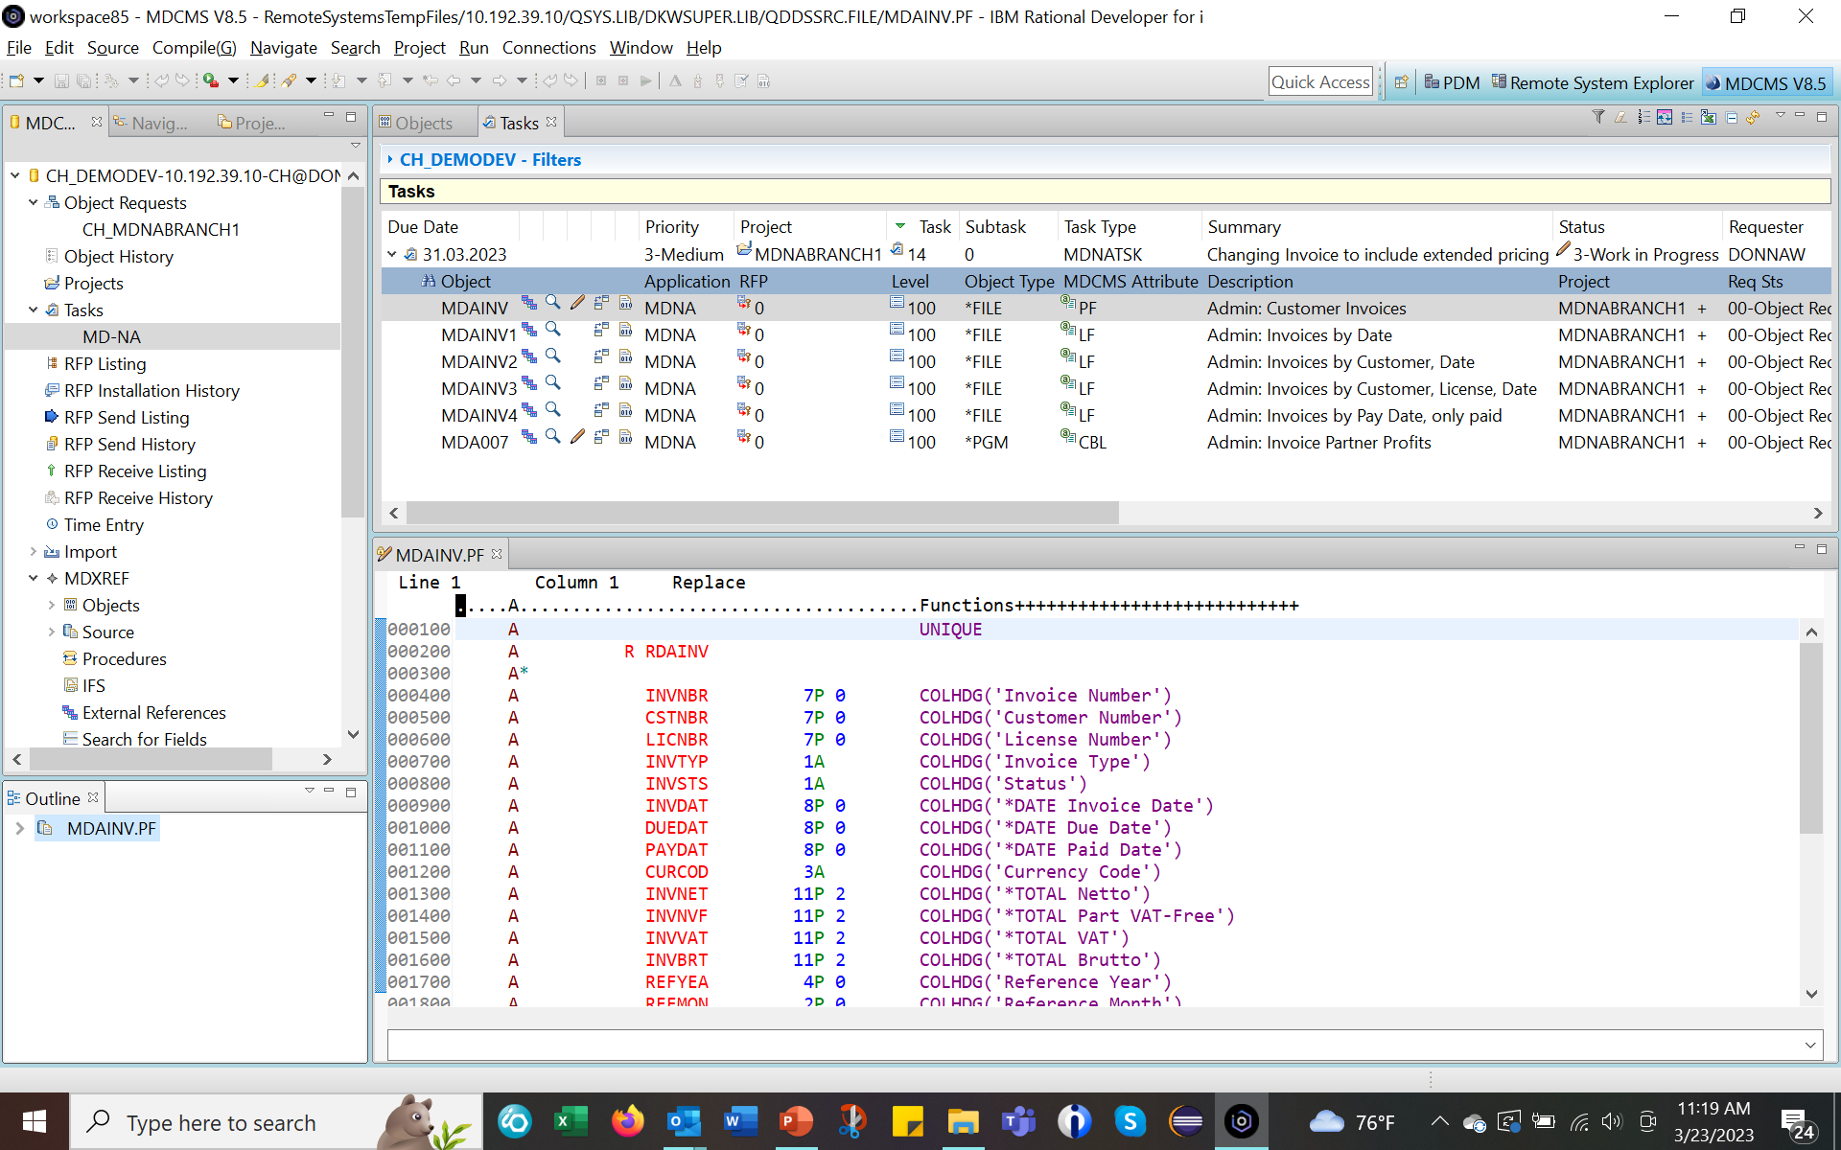
RDi

Slide 11
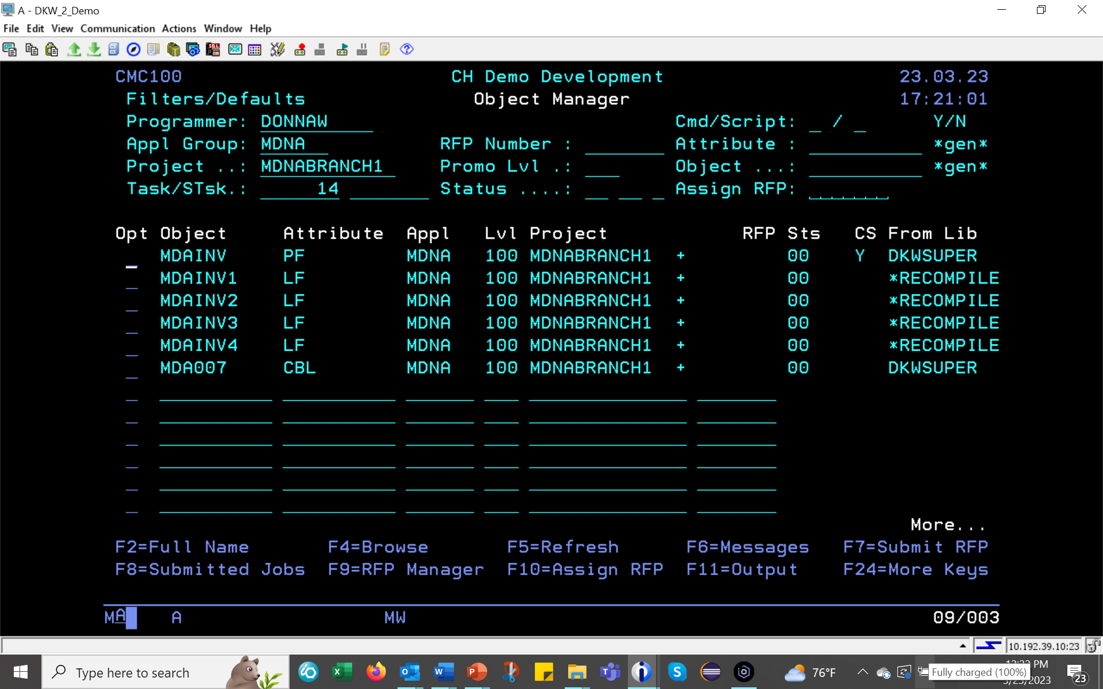
Green Screen

Slide 12
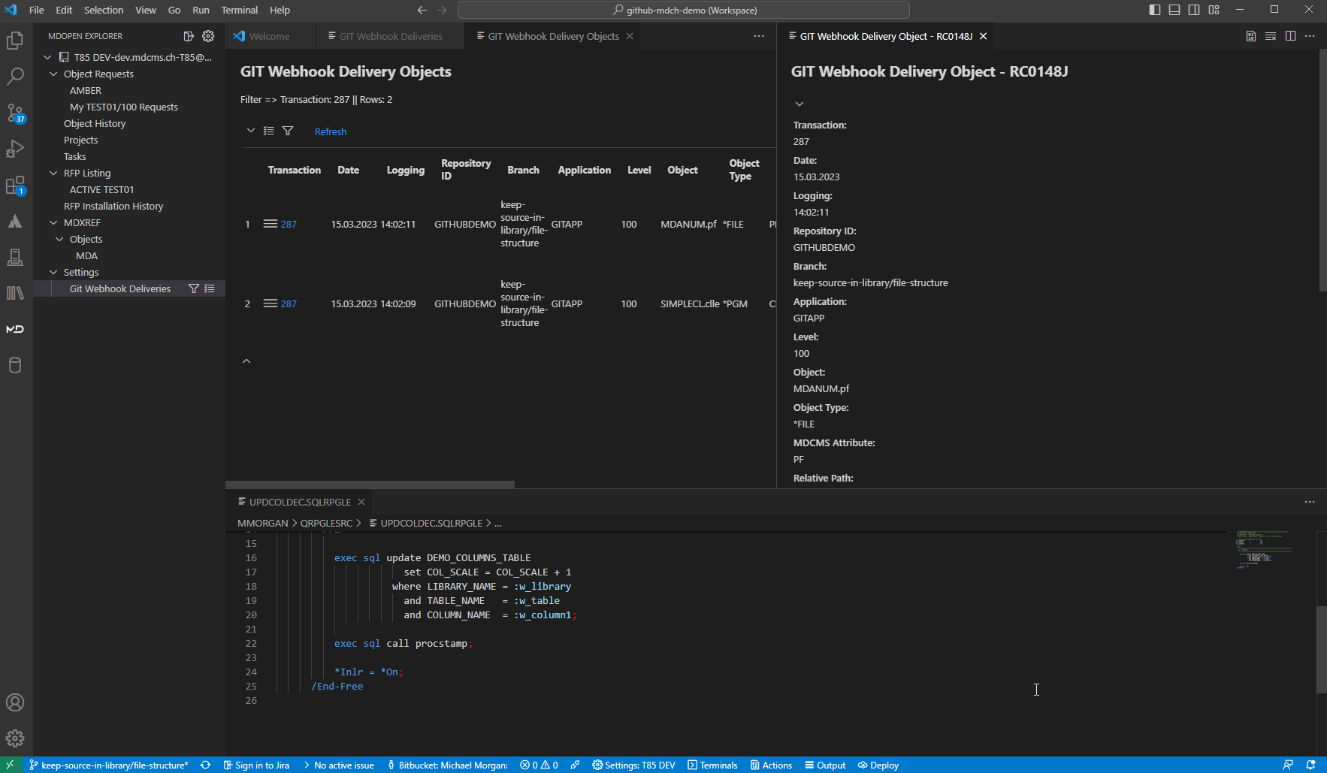
VS Code

Slide 13
DevOps & CI/CD Pipelines

Slide 14
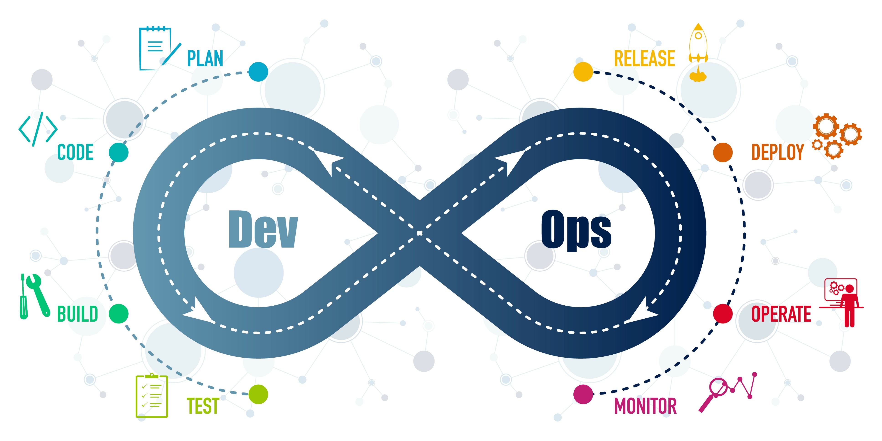

Slide 15
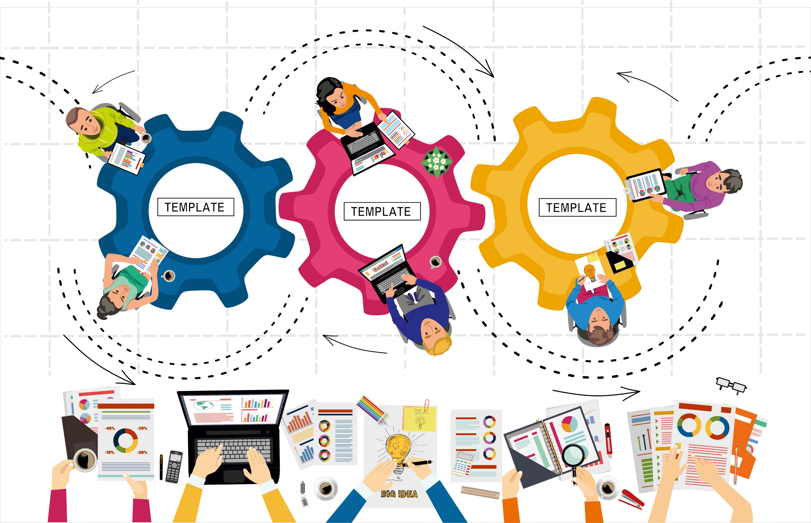
Waterfall
Hybrid
Agile
Agile

Slide 17
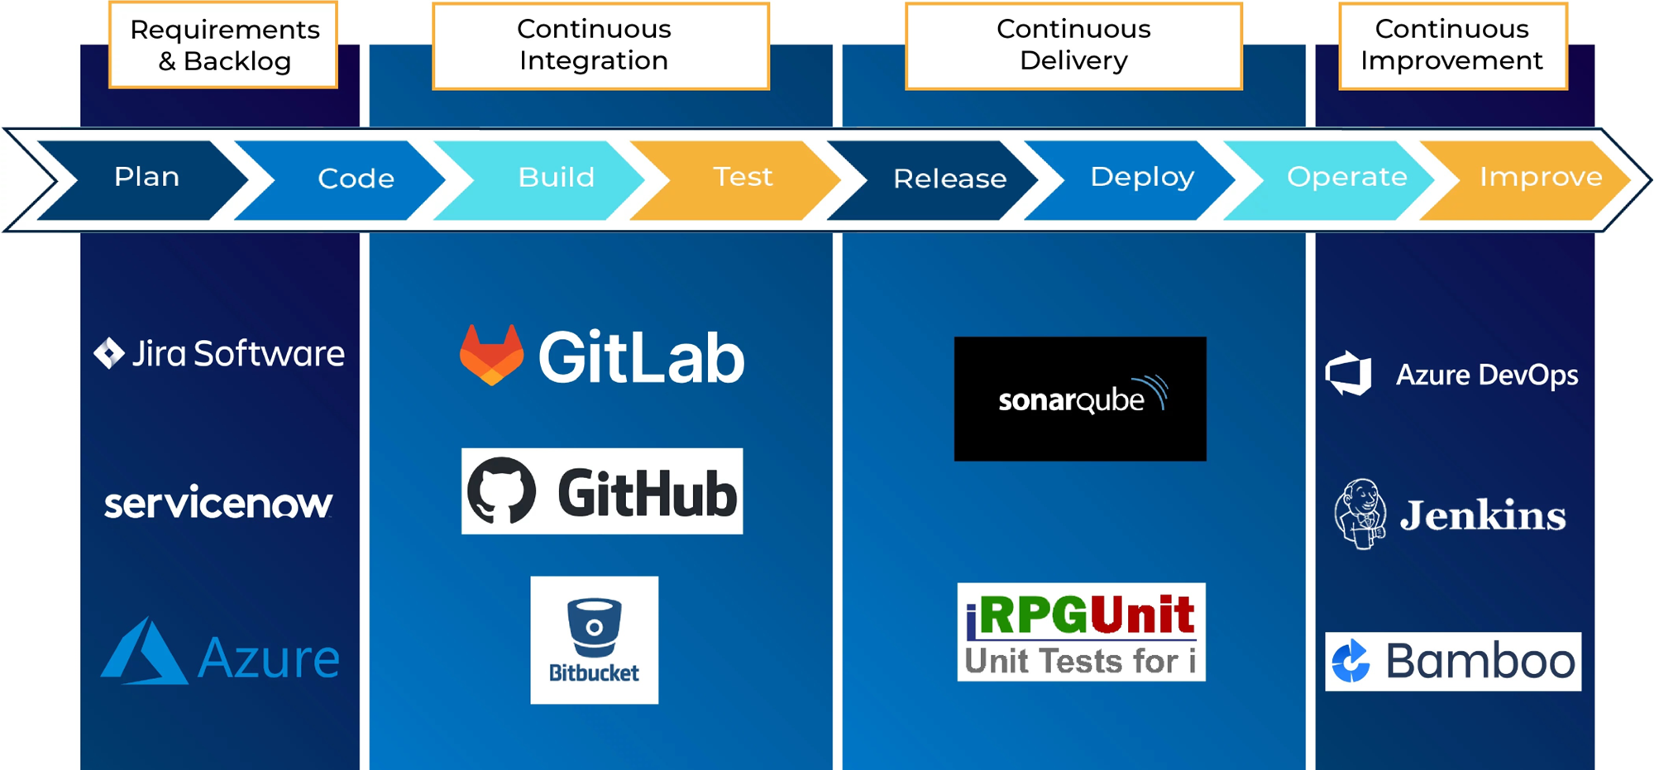

Slide 18
Roadmap to CI/CD
Determine project management strategy
Identify IBM i centric testing environments including external dependencies
Implement new automation tools
1
3
5
2
4
6
Evaluate existing tools against new strategy
Identify links to existing automation tools
Evaluate and adjust new processes

Slide 19
MDChange
MDWorkflow
Project Integration
Bi-directional status & state updates
Agile development support
CI/CD support
MDCMS
Facilitate controlled change
MDOpen
Your choice of IDEs
MDXREF
Impact analysis
Dependency checking
Field Level analysis
MDTransform
Data transformation with SQL
Eliminate conversion & plug programs
Refresh test data
MDRapid
Lightening fast data file updates

Slide 20
Choose Your IDE

Slide 21
RDi

Slide 22
Green Screen

Slide 23
VS Code

Slide 24
MDChange
MDWorkflow
Project Integration
Bi-directional status & state updates
Agile development support
CI/CD support
MDCMS
Facilitate controlled change
MDOpen
Your choice of IDEs
MDXREF
Impact analysis
Dependency checking
Field Level analysis
MDTransform
Data transformation with SQL
Eliminate conversion & plug programs
Refresh test data
MDRapid
Lightening fast data file updates

Slide 25
The Power of REST APIs

Slide 26
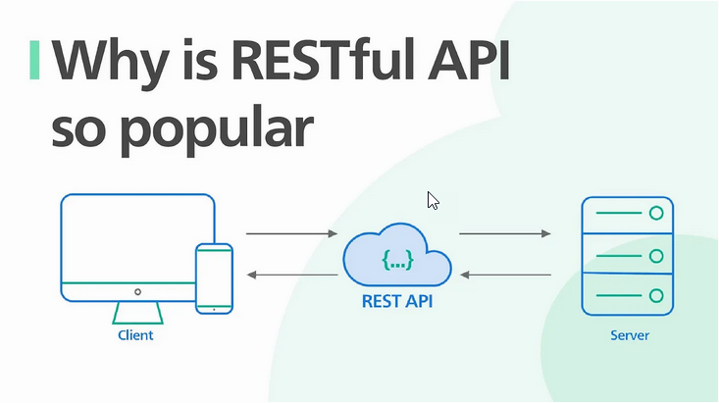

Slide 27
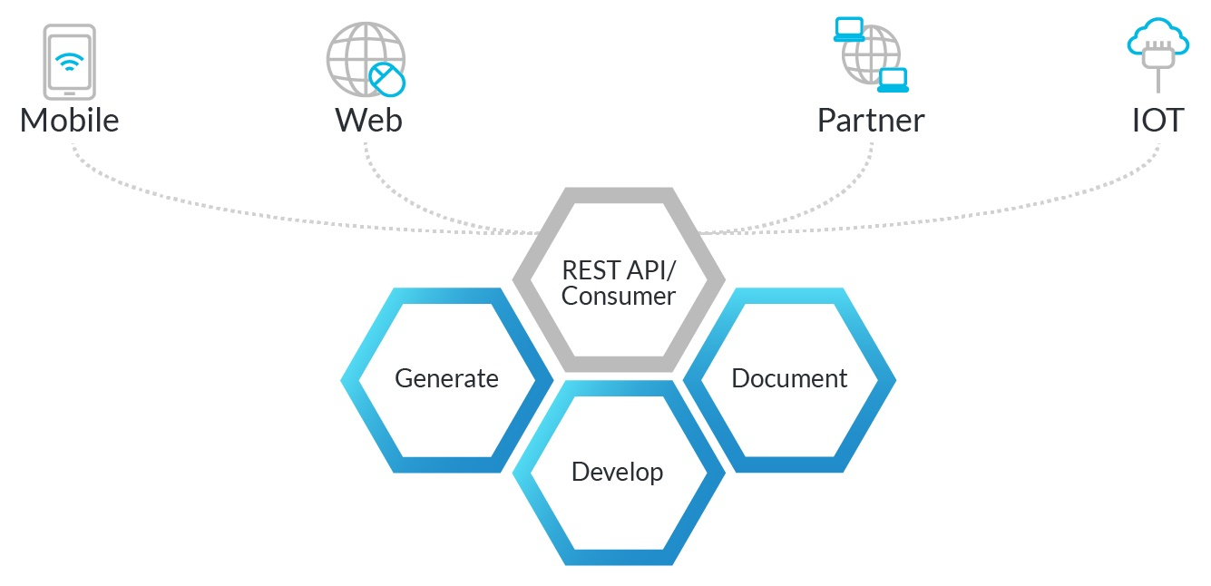
MDRest4i

Slide 28
V13 Enhancements
Cleaner, easier to maintain, code.
Performance improvements.
Continued support for RPG
Added support for COBOL, CL, C/C++
The "SK Edition"
Taking advantage of Scott Klement's 20+ years of experience with APIs and Web Services

Slide 29
MDRest4i V13 Sneak Peek

Slide 30
Q&A

Slide 31
Learn More
Contact Us to Get Started
Email info@md-na.com
On the web:
https://www.md-na.com/schedule-a-demo/
About Our Solutions
www.midrangedynamics.com

